Slide 1
lab 5 Gram Stain Lecturer Reham M.M. AL-Mosawi Medical Microbiology (Bacteriology)

Slide 2
Gram stain
Is the important and useful differential stain in the bacteriology. It divided bacteria in to two major groups G+ and G- based on the physical and chemical composition of the bacterial cell wall.

Slide 3
Importance of Gram Stain:-
1- Bacterial taxonomy (classification)
2- Cell wall structure
3- Identification of infectious causative agent
4- Guided the selection of the correct drug for an infection.

Slide 4
Gram Stain
Most important differential staining technique
Uses more than one dye
Helps distinguish between different kinds of bacteria
(Differentiates all bacteria based on cell wall composition)
Bacteria are either Gram + ( stain blue )or Gram- ( stain
red)
Gram stain is usually the first step in identifying an
unknown bacteria
Developed by Christian Gram in 1884

Slide 5
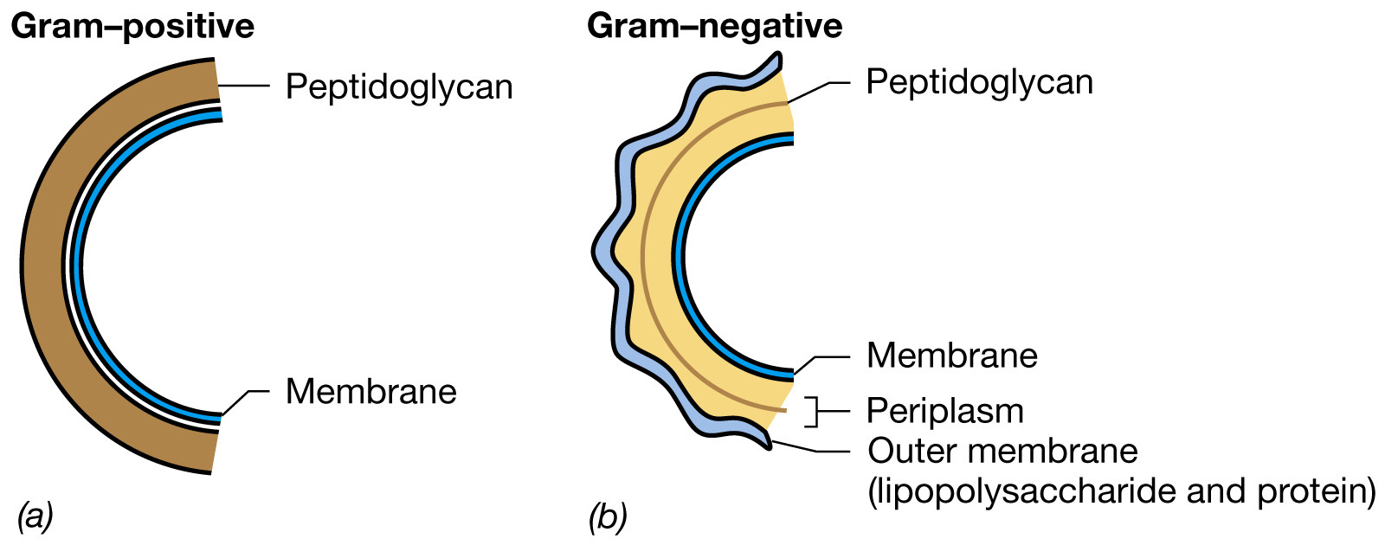
Notes:
Figure: 04-28
Caption:
Cell walls of Bacteria. (a,b) Schematic diagrams of gram-positive and gram-negative cell walls.

Slide 6
Procedure
1- Prepare smear from cultures
2- Flood the smear with crystal violet (primary stain) in procedure & let stand for 1 minute
3- Wash with tap water
4- Flood smear with grams iodine and let stand for 1 minute
5- Wash with tap water
6- Decolorized with 95% alcohol for 15-30 seconds added as drop by drop
7- Wash with tap water
8- Counter stain with safranine for 1-1.30 minute
9- Wash with tap water
10- Let dry with filter paper & examine under oil immersion

Slide 7
Gram Stain

Slide 8
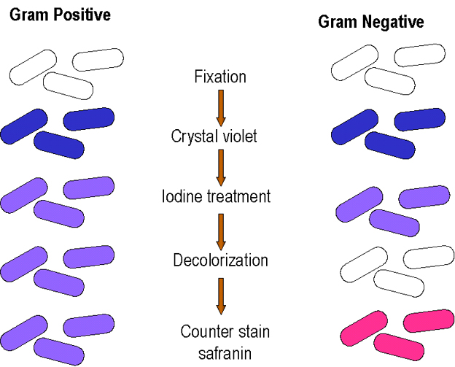
Gram stain

Slide 9
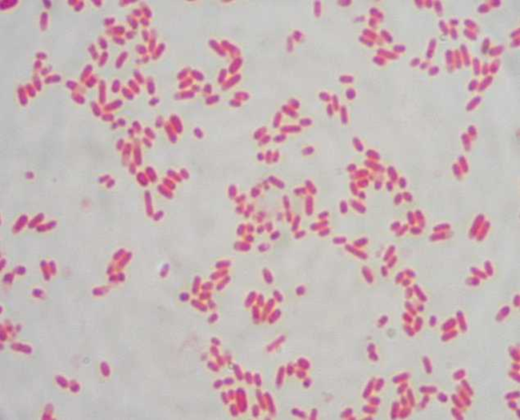
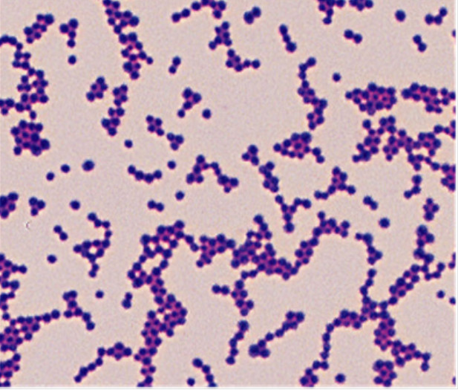
Gram negative
Gram positive

Slide 10
Thank you!

